Slide 1
Aspect Level Sentiment Classification with Deep Memory Network
Duyu Tang, Bing Qin∗ , Ting Liu Harbin Institute of Technology, Harbin, China {dytang, qinb, tliu}@ir.hit.edu.cn
——郁

Slide 2
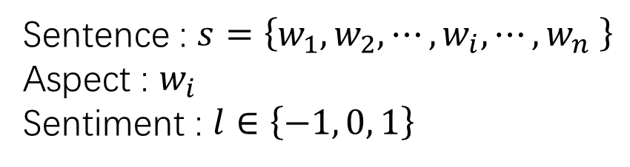
Problem definition
SemEval-2014 Task4: Aspect Based Sentiment Analysis
Sentence : $s=\left\{w_{1},w_{2},⋯,w_{i},⋯,w_{n} \right\}$
Aspect : $w_{i}$
Sentiment : $l∈\left\{−1, 0, 1\right\}$
e.g.1
Sentence : But the $T$ was so horrible to us .
Aspect : Staff
Sentiment : -1
SemEval-2016 Task 5: Aspect Based Sentiment Analysis

Slide 3
e.g.2
I had a terrific $T$ , and our server guided us toward a very nice wine in our price range , instead of allowing us to purchase a similarly priced wine that was n't as good .
Meal
1
I had a terrific meal , and our $T$ guided us toward a very nice wine in our price range , instead of allowing us to purchase a similarly priced wine that was n't as good .
Server
1
I had a terrific meal , and our server guided us toward a very nice $T$ in our price range , instead of allowing us to purchase a similarly priced wine that was n't as good .
Wine
1
I had a terrific meal , and our server guided us toward a very nice wine in our price range , instead of allowing us to purchase a similarly priced $T$ that was n't as good .
Wine
-1
I had a terrific meal , and our server guided us toward a very nice wine in our price range , instead of allowing us to purchase a similarly $T$ wine that was n't as good .
Priced
0

Slide 4
Related works
Majority : 在训练集上面向对象训练
Feature-based SVM : 特征工程，包括ngram features、parse features and lexicon features（best）
LSTM -> TDLSTM : Using two LSTM networks, a forward one and a backward one, towards the aspect
ContextAVG : Context word vectors are averaged and the result is added to the aspect vector.

Slide 5
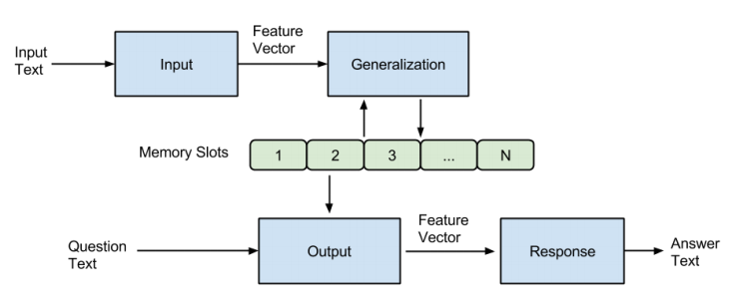
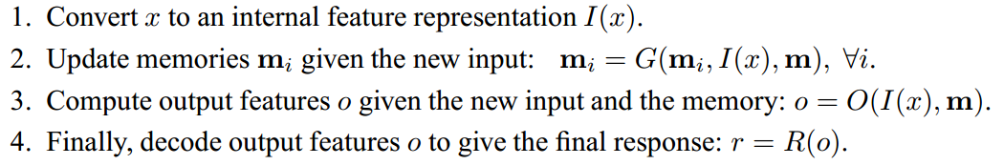
Memory Network

Slide 6
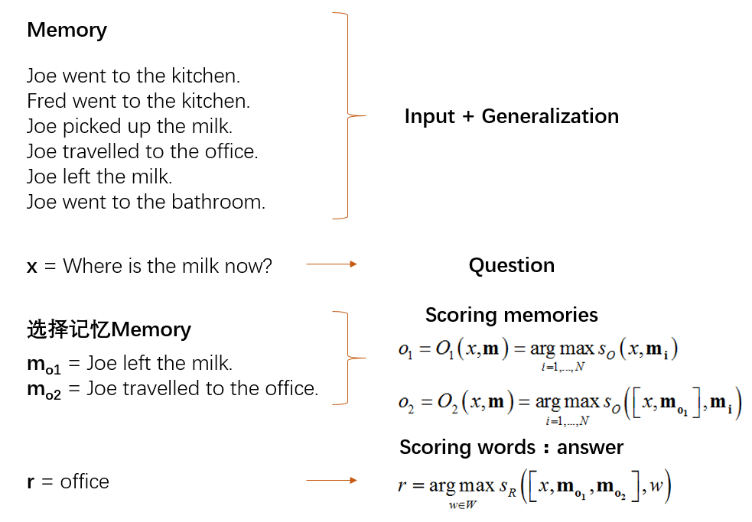

Slide 7
Model
$$w_{1},w_{2},⋯,w_{i−1},w_{i},w_{i+1},⋯,{w_{n−1},w}_{n}$$

Slide 8
Model
Context embedding matrix
context words
$$w_{1},w_{2},⋯,w_{i−1},w_{i},w_{i+1},⋯,{w_{n−1},w}_{n}$$
Aspect vector
aspect word

Slide 9
Model
Context embedding matrix
Attention
context words
$$w_{1},w_{2},⋯,w_{i−1},w_{i},w_{i+1},⋯,{w_{n−1},w}_{n}$$
Aspect vector
aspect word

Slide 10
Model
Context embedding matrix
Attention
context words
$$w_{1},w_{2},⋯,w_{i−1},w_{i},w_{i+1},⋯,{w_{n−1},w}_{n}$$
Aspect vector
aspect word

Slide 11
Model
Aspect vector
Context embedding matrix
Attention
context words
$$w_{1},w_{2},⋯,w_{i−1},w_{i},w_{i+1},⋯,{w_{n−1},w}_{n}$$
Aspect vector
aspect word

Slide 12





Hidden_size : d
Context_size : k
$${v∈R}^{d×1}$$
Aspect vector
$${o∈R}^{d×1}$$
Context embedding matrix
$${m∈R}^{d×k}$$
$${α∈R}^{k×1}$$
Attention
context words
$$w_{1},w_{2},⋯,w_{i−1},w_{i},w_{i+1},⋯,{w_{n−1},w}_{n}$$
Aspect vector
aspect word
$${v∈R}^{d×1}$$

Slide 13




$$m=v_{context}⊙δ\left(l_{context}\right)$$
Aspect vector
Context embedding matrix
$${m∈R}^{d×k}$$
context words
Attention
$$w_{1},w_{2},⋯,w_{i−1},w_{i},w_{i+1},⋯,{w_{n−1},w}_{n}$$
Aspect vector
aspect word
$${v_{aspect}∈R}^{d×1}$$

Slide 14



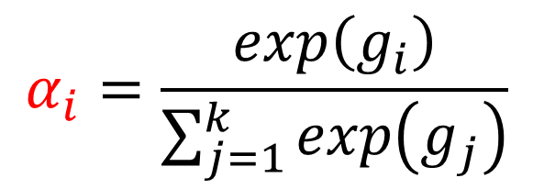

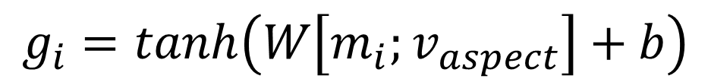



$$m=v_{context}⊙δ\left(l_{context}\right)$$
Aspect vector
$${∈R}^{1×1}$$
$${∈R}^{1×2d}$$
$${∈R}^{d×1}$$
$${∈R}^{d×1}$$
Context embedding matrix
$$g_{i}=tanh\left(W\left[m_{i};v_{aspect}\right]+b\right)$$
$${α∈R}^{k×1}$$
context words
Attention
$$α_{i}=\frac{exp\left(g_{i}\right)}{\sum_{j=1}^{k}{exp\left(g_{j}\right)}}$$
$${∈R}^{1×1}$$
$$w_{1},w_{2},⋯,w_{i−1},w_{i},w_{i+1},⋯,{w_{n−1},w}_{n}$$
Aspect vector
aspect word

Slide 15

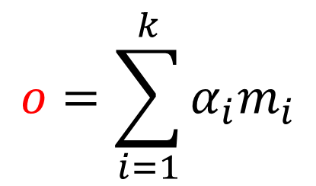
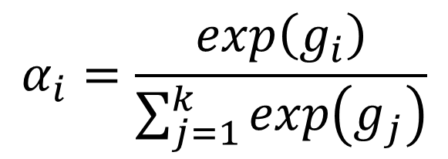

$$m=v_{context}⊙δ\left(l_{context}\right)$$
Aspect vector
$${o∈R}^{d×1}$$
Context embedding matrix
$$g_{i}=tanh\left(W\left[m_{i};v_{aspect}\right]+b\right)$$
context words
Attention
$$α_{i}=\frac{exp\left(g_{i}\right)}{\sum_{j=1}^{k}{exp\left(g_{j}\right)}}$$
$$w_{1},w_{2},⋯,w_{i−1},w_{i},w_{i+1},⋯,{w_{n−1},w}_{n}$$
Aspect vector
aspect word
$$o=\sum_{i=1}^{k}{α_{i}m_{i}}$$
$${∈R}^{d×1}$$

Slide 16
Aspect vector
R
Context embedding matrix
m
O
R
context words
Attention
$$w_{1},w_{2},⋯,w_{i−1},w_{i},w_{i+1},⋯,{w_{n−1},w}_{n}$$
I
Aspect vector
aspect word

Slide 17
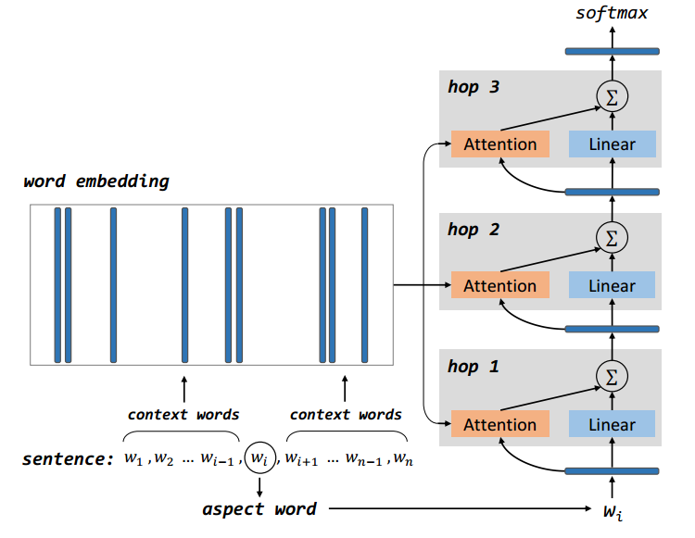
Aspect vector
Context embedding matrix
context words
Attention
$$w_{1},w_{2},⋯,w_{i−1},w_{i},w_{i+1},⋯,{w_{n−1},w}_{n}$$
Aspect vector
aspect word
One Hop(Layer)
Multi Hop

Slide 18
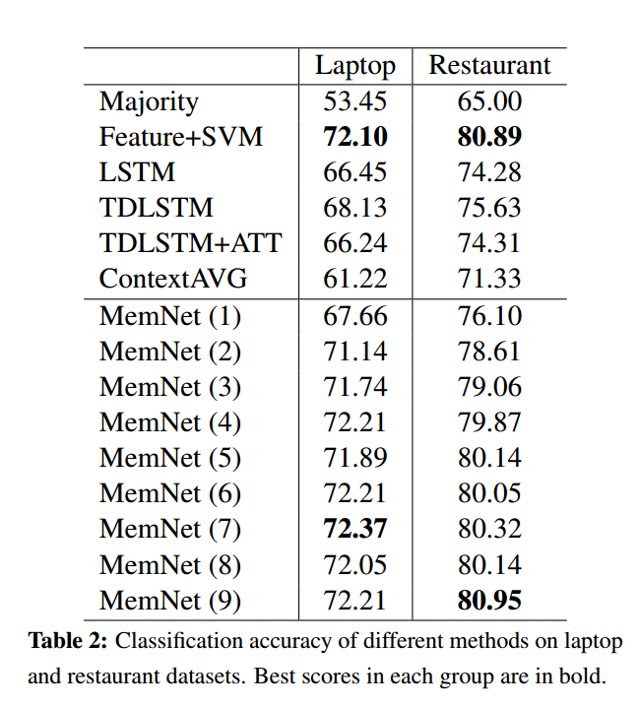
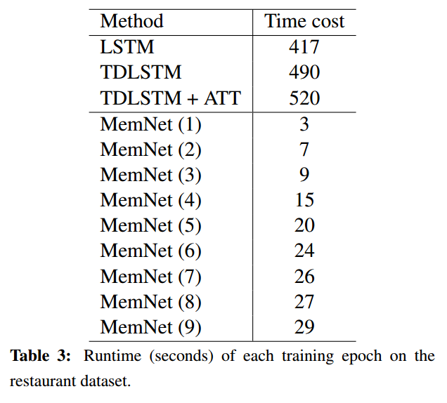
Result

Slide 19
MemNet与其他NN关系的讨论
——与前馈网络
——与循环网络
——FastText为何有效

Slide 20
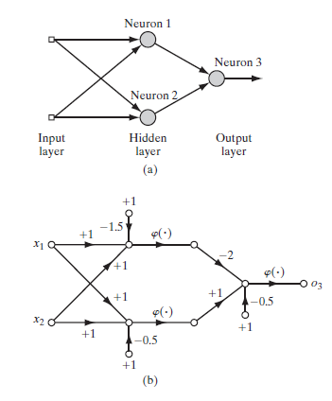
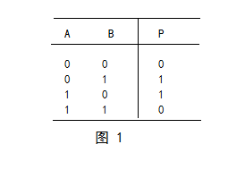
NN能否做乘法？
异或门的实现

Slide 21
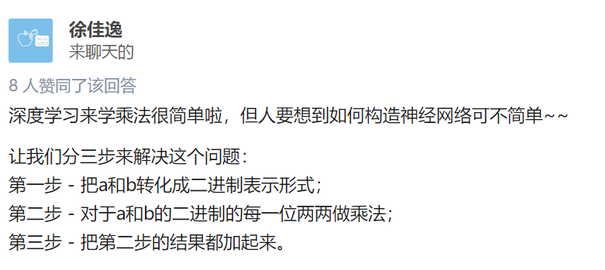
NN能否做乘法？
仅通过全连接神经网络和非线性激活函数能否实现乘法？

